Slide 1
Story 1
Preconditions – Step00
AMG54556/001 Top Level HSUVExample released and Open in Teamcenter Rich Client Requirements Manager

Slide 2
Preconditions – Step00 – Teamcenter View

Slide 3
Preconditions – Step00 – Topcased Model View – Top Level Product (Context)

Slide 4
Preconditions – Step00 – Topcased Model View – Problem Item (Requirement)

Slide 5
Preconditions – Step00 – TBD ALM Requirements Client View

Slide 6
Story 1 Step0.1 – Change Requirements to 2016 ULEV - Marketing opens change request (Teamcenter Thin Web Client View)
Need to change vehicle to meet 2016 ULEV standards
Change request has problem item REQ-020144/A attached
Change request has reference item AMG54556/001 attached (this is the context, unconfigured for this step)

Slide 7
Story 1 Step0.1 – Teamcenter View (Creating Change Request)

Slide 8
Story 1 Step0.1 – Teamcenter View

Slide 9
Story 1 Step0.1 – TBD ALM Requirements Client View

Slide 10
Story 1 Step0.2 Released REQ-020144/A is revised to begin work on version “B” Teamcenter View

Slide 11
Story 1 Step0.3 When version “B” is finished it is released, then next higher assembly (REQ-020181/A) is revised to include this new version, and released

Slide 12
Story 1 Step0.3 When version “B” is finished it is released, then next higher assembly (REQ-020181/A) is revised to include this new version, and released

Slide 13
Story 1 Step0.3 When version “B” is finished it is released, then next higher assembly (REQ-020181/A) is revised to include this new version, and released

Slide 14
Story 1 Step0.4 Same sequence for each level to the top of the requirements tree (AKY251614/A) Becomes /B from the change

Slide 15
Story 1 Requirements Steps Postcondition Released requirements context now has AMG54556/002, AKY251614/B, REQ-020181/B, REQ-020144/B, rest are not changed

Slide 16
Story 1 Requirements Steps Postcondition Change Request remains open, and has AMG54556/002, AKY251614/B, REQ-020181/B, REQ-020144/B attached as Solution Items

Slide 17
Story 1 Requirements Steps Postcondition Topcased Eco-Friendliness REQ-020181/B

Slide 18
Story 1 Requirements Steps Postcondition Topcased HSUV Specification AKV251614/B

Slide 19
Story 1 Requirements Steps Postcondition Topcased top level context HSUVExample AMG54559/002

Slide 20
Story 1 Step1.0 Original change request remains open, related structure items must be fixed to meet the revised requirement
Follow the <<satisfy>> link from REQ-000144/A to find PowerSubsystem AMG60104/001, add it to the list of problem items on the change request, add the top level HybridSUV (AMG60112/001) item as reference
Revise released AMG60104/001 to version 002 and begin changes to meet new requirement

Slide 21
Story 1 Step 1.0 Teamcenter View Showing Problem Items on 00020GMO/001 Change Request

Slide 22
Story 1 Step 1.0 Teamcenter View Following <<satisfy>> Relationship from REQ-020144/A to Design AMG60104/001

Slide 23
Story 1 Step1.1 Create new versions of PowerControlUnit, Hardware, BoardSupportSoftware, FuelTankAssembly, ApplicationSoftware and Calibrations to meet new requirement
Attach each original version to the change request as problem items (NOTE: This could have been done when the initial change request was created by following the links from the requirement that was attached)
Attach the revised versions as solution items
NOTE: ApplicationSoftware and Calibrations should probably be further decomposed and the change should roll down to internal items inside them, such as a specific version of a specific software component, etc. to illustrate the ALM connectivity to the context

Slide 24
Story 1 Step 1.1 Teamcenter View Showing Change 000020GMO/001 with Problem Items Added

Slide 25
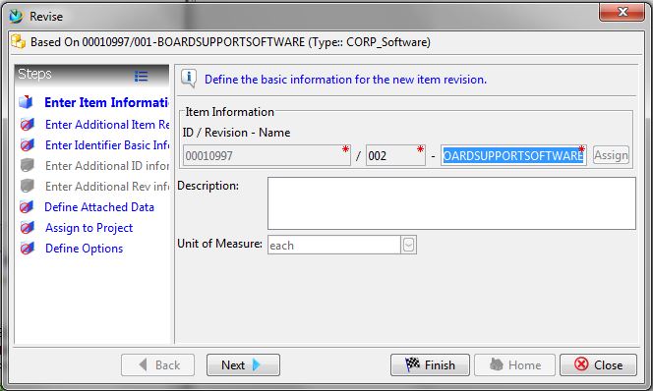
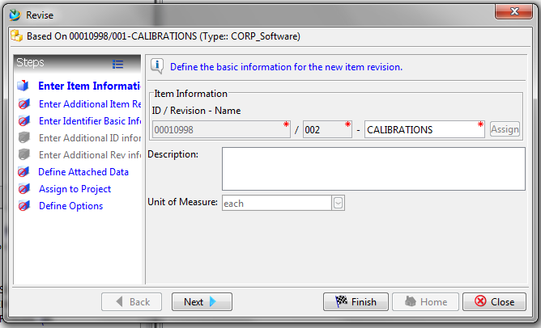
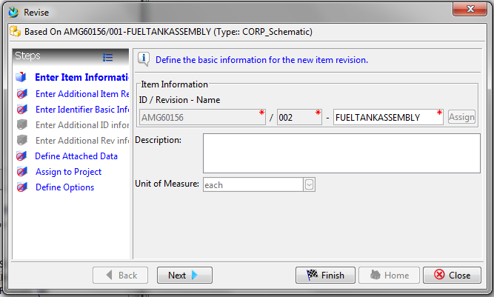
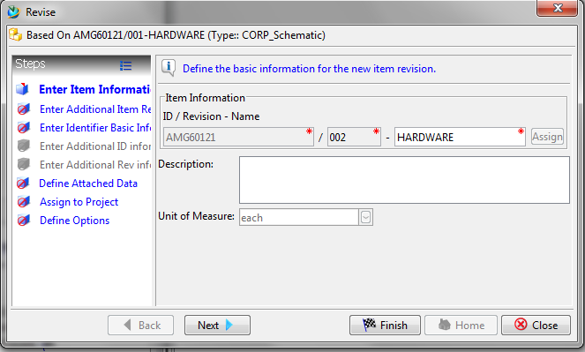
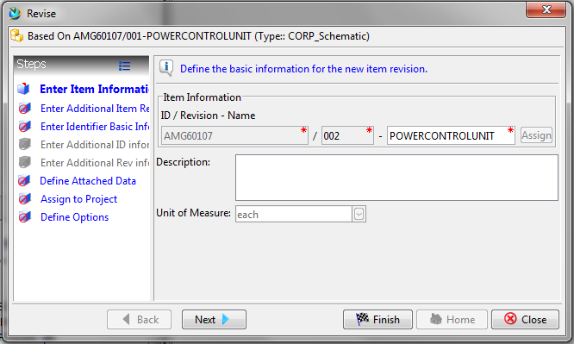
Story 1 Step 1.1 Teamcenter View - Revising Problem Items

Slide 26
Story 1 Step 1.1 Teamcenter View Showing Change 000020GMO/001 with Solution Items Added

Slide 27
Story 1 Step1.2 Topcased View – Replaced BoardSupportSoftware and Hardware in New Version of PowerControlUnit

Slide 28
Story 1 Step1.2 Topcased View – Replaced PowerControlUnit and FuelTankAssembly in New Version of PowerSubsystem

Slide 29
Story 1 Step1.2 Teamcenter View - Replacing BoardSupportSoftware in PowerControlUnit

Slide 30
Story 1 Step1.2 Teamcenter View - Replacing Hardware in PowerControlUnit

Slide 31
Story 1 Step1.2 Teamcenter View - Replacing PowerControlUnit in PowerSubsystem

Slide 32
Story 1 Step1.2 Teamcenter View - Replacing ApplicationSoftware in PowerSubsystem

Slide 33
Story 1 Step1.2 Teamcenter View - Replacing Calibrations in PowerSubsystem

Slide 34
Story 1 Step1.2 Teamcenter View - Replacing FuelTankAssembly in PowerSubsystem

Slide 35
Story 1 Step1.2 - Release All Changed Design (Structure) Objects
After Making Required Changes in…
Hardware
BoardSupportSoftware
FuelTankAssembly
ApplicationSoftware
Calibrations
…and Replacing the Old Revisions of Same in PowerSubsystem…
…Release All the Changed Objects

Slide 36
Story 1 Step1.2 Teamcenter View - Begin to Release All the Changed Objects

Slide 37
Story 1 Step1.2 Teamcenter View – Finish Release All the Changed Objects

Slide 38
Story 1 Step1.3 Teamcenter View – Revising HybridSUV Design

Slide 39
Story 1 Step1.3 Topcased View – Replaced PowerSubsystem, ApplicationSoftware and Calibrations in New Version of HybridSUV

Slide 40
Story 1 Step1.3 Topcased View – Replaced HybridSUV in New Version of HSUVExample

Slide 41
Story 1 Step1.3 Teamcenter View – Replacing PowerSubsystem in HybridSUV Design

Slide 42
Story 1 Step1.3 Topcased View – Create Satisfy Links from Revised PowerSubsystem to Revised Emissions Requirement

Slide 43
Story 1 Step1.3 Teamcenter View – Create Satisfy Links from Revised PowerSubsystem to Revised Emissions Requirement

Slide 44
Story 1 Step1.3 Teamcenter View –Revised PowerSubsystem Traceability

Slide 45
Story 1 Step1.3 Teamcenter View – Release Entire HSUVExample and Revised HybrivSUV Design

Slide 46
Story 1 Step1.4 Close the change request as complete
This step may be automatic based on how the change request system is configured to handle closing of the change based on release of the solution items.
In this case the CR is governed by a simple Teamcenter signoff workflow

Slide 47
Story 1 Step1.4 Teamcenter View – Begin CR Signoff

Slide 48
Story 1 Step1.4 Teamcenter View – Perform CR Signoff

Slide 49
Story 1 Step1.4 Teamcenter View – CR is Complete

Slide 50
Story 1 Postcondition Teamcenter View

